Slide 1
Introduction to
Machine Learning Algorithms
Instructor: Dr. Jeff Fortuna, B. Eng, M. Eng, PhD, (Electrical Engineering), McMaster University
email: fortunjj@mcmaster.ca

Slide 2
K Nearest Neighbors Classification

Slide 3
Motivation
Consider the following (partial) data from Assignment 1
Note that we have a variable (Gender) that is categorical (Nominal)
This naturally divides the data into two classes (male and female)
We can use this data as a training set
Let’s have a look at the data
 | Gender (M/F) | Weight (lbs) | Height (in)
1 | M | 68 | 58
2 | M | 175 | 73
3 | F | 156 | 63
4 | M | 210 | 75
5 | F | 145 | 64
6 | F | 131 | 66
7 | M | 182 | 71
8 | F | 125 | 60
9 | M | 219 | 72
10 | M | 158 | 68

Slide 4
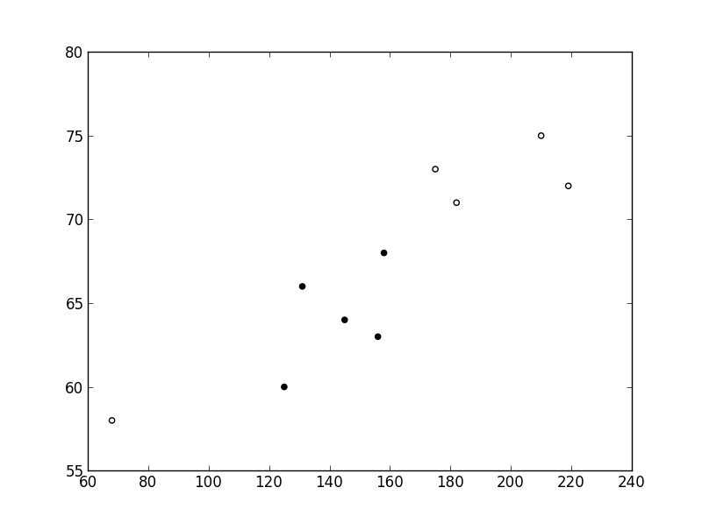
Nearest Neighbor Classifier
Male
Female
3 nearest neighbors
By majority vote, the unknown (test) sample is male
Height (in)
Weight (lbs)
From the plot it is quite clear that for subjects with a height between 50 and 80 inches, if the weight is bigger than about 165 pounds, the subject is male.
One very simple approach to classifying an unknown sample would be to examine the classes of training samples that are nearest to our unknown sample and determine the class of the unknown sample by a majority vote.
This approach is called a nearest neighbor classifier.

Slide 5
Nearest Neighbor Algorithm
For an unknown test sample X, a pseudocode description of the approach to classify X is:
  For every point in our training dataset:
    calculate the distance between X and the current point
    sort the distances in increasing order
    take k items with lowest distances to X
    find the majority class among these items
    return the majority class as our prediction for the class of X

Slide 6
Decision Trees

Slide 7
What is a Decision Tree?
An inductive learning task
  Use particular facts to make more generalized conclusions
A predictive model based on a branching series of Boolean tests
  These smaller Boolean tests are less complex than a one-stage classifier
Let’s look at a sample decision tree…

Slide 8
Predicting Commute Time
Leave At
If we leave at 10 AM and there are no cars stalled on the road, what will our commute time be?
10 AM
9 AM
8 AM
Stall?
Accident?
No
Yes
Long
No
Yes
Short
Long
Medium
Long

Slide 9
Decision Tree Algorithms
The basic idea behind any decision tree algorithm is as follows:
  Choose the best attribute(s) to split the remaining instances and make that attribute a decision node
  Repeat this process for recursively for each child
  Stop when:
    All the instances have the same target attribute value
    There are no more attributes
    There are no more instances

Slide 10
Identifying the Best Attributes
Refer back to our original decision tree
Leave At
10 AM
9 AM
8 AM
Stall?
Accident?
Long
No
Yes
No
Yes
Short
Long
Medium
Long
How did we know to split on leave at and then on stall and accident and not weather?

Slide 11
ID3 Heuristic
To determine the best attribute, we look at the ID3 heuristic
ID3 splits attributes based on their entropy.
Entropy is the measure of disinformation…

Slide 12
Bayesian Classification

Slide 13
Use of Bayes’ Theorem
This theorem is commonly used in a scenario when you have the (a priori) probabilities of an event B occurring given that a number of events A have occurred.
The question that you want to answer in this scenario is to work backwards – i.e. what is the probability that one of the events A occurred given that B occurred.
This comes up frequently in data mining, where I have, for example, the event that data X_{i} that occurred with probability P(X_{i}) belonged to class C, i.e. P(X|C)
What I then want to answer is: “what is the probability of class C if I observe data X?”, i.e. P(C|X). Once I calculate this, I simply choose the class with the largest probability.
P(X)
P(X|C=1)
P(X|C=2)
P(C=1)
P(C=2)

Slide 14
Classification Formulation
Let C_{j} be the mutually exclusive and exhaustive event that a data element X is observed to belong to class j. Now, using Bayes’ theorem
Note: What this says is that if I observe data element X and its class C and I have some idea of the priori probability of the class C_{j}, I can determine the probability that when I have data element X, class C_{j} is associated with it.

Slide 15
Naïve Bayes Classifier (I)
This allows us to use Bayes’ theorem as
We will also ignore the denominator in Bayes’ theorem, since it is summed over all C_{j}
Now all we have to do is compute P(C_{j} | X) for an unknown data point X and choose the class j with the largest probability.

Slide 16
Play-tennis example: estimating P(x_{i}|C)
outlook
P(sunny|p) = 2/9
P(sunny|n) = 3/5
P(overcast|p) = 4/9
P(overcast|n) = 0
P(rain|p) = 3/9
P(rain|n) = 2/5
temperature
P(hot|p) = 2/9
P(hot|n) = 2/5
P(mild|p) = 4/9
P(mild|n) = 2/5
P(cool|p) = 3/9
P(cool|n) = 1/5
humidity
P(high|p) = 3/9
P(high|n) = 4/5
P(p) = 9/14
P(normal|p) = 6/9
P(normal|n) = 2/5
P(n) = 5/14
windy
P(true|p) = 3/9
P(true|n) = 3/5
P(false|p) = 6/9
P(false|n) = 2/5

Slide 17
Play-tennis example: classifying X
An unseen sample X = <rain, hot, high, false>
P(X|p)·P(p) = P(rain|p)·P(hot|p)·P(high|p)·P(false|p)·P(p)
= (3/9)(2/9)(3/9)(6/9)(9/14) = 0.010582
P(X|n)·P(n) = P(rain|n)·P(hot|n)·P(high|n)·P(false|n)·P(n)
= (2/5)(2/5)(4/5)(2/5)(5/14) = 0.018286
Sample X is classified in class n (don’t play)

Slide 18
AdaBoost

Slide 19
Boosting
In this approach, we are going to train each classifier sequentially.
Each classifier is trained based on the performance of those already trained
There are many ways of implementing boosting, but we are going to look at only one in detail – adaptive boosting or AdaBoost

Slide 20
General Idea of AdaBoost
A weight is applied to every example in the training data. Initially these weights are all equal
Train a weak classifier on the training data
Errors from the weak classifier are calculated, and the weak classifier is trained a second time with the same dataset.
This second time the weak classifier is trained, the weights of the training set are adjusted so that the examples properly classified the first time are weighted less and the examples incorrectly classified in the first iteration are weighted more
Final classifier is the weighted sum of weak learners
Notes:
The goal of boosting is to improve the accuracy of any given learning algorithm.
Consider creating three component classifiers for a two-category problem through boosting.
First, ……, call this set D1. Based on D1, train the first classifier, C1.
Now, we seek a second training set D2, half of the patterns in D2 should be correctly classified by C1, half incorrectly classified by C1.
Next, we seek a third data set D3,

Slide 21
A toy example
Training set: 10 points (represented by plus or minus)
Original Status: Equal Weights for all training samples

Slide 22
A toy example(cont’d)
Final Classifier: integrate the three “weak” classifiers and obtain a final strong classifier.

Slide 23
Logistic Regression Classification

Slide 24
Turning Regression Into Classification
Try a simple idea:
  Assume that the output variable Y is discrete and takes on one of two values – representing the class of the input variable.
To do this, we will change the model so that the standard regression model is mapped through a function with an output that tends towards one of two values.
This function is called the logistic function

Slide 25
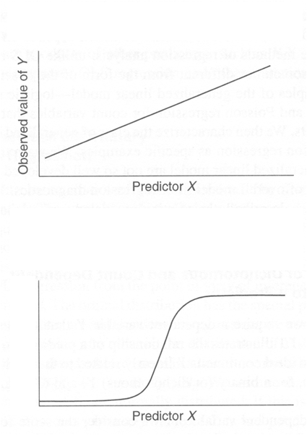
Logistic Function
Linear Regression
Logistic Regression
Observed Class of Y

Slide 26
Support Vector Machine Classification

Slide 27
Classifier Margin
x
x
f
f
y^{est}
y^{est}
f(x,w,b) = sign(w x + b)
f(x,w,b) = sign(w x + b)
denotes +1
denotes -1
denotes +1
denotes -1
Define the margin of a linear classifier as the width that the boundary could be increased by before hitting a datapoint.
Define the margin of a linear classifier as the width that the boundary could be increased by before hitting a datapoint.

Slide 28
Maximum Margin
Maximizing the margin is good according to intuition theory
Implies that only support vectors are important; other training examples are ignorable.
This approach is called structural risk minimization
f(x,w,b) = sign(w x + b)
denotes +1
denotes -1
The maximum margin linear classifier is the linear classifier with the, um, maximum margin.
This is the simplest kind of SVM (Called an LSVM)
Support Vectors are those datapoints that the margin pushes up against
Linear SVM

Slide 29
Non-linear SVMs
Datasets that are linearly separable with some noise work out great:
But what are we going to do if the dataset is just too hard?
How about… mapping data to a higher-dimensional space:
0
x
0
x
x²
0
x

Slide 30
Neural Network

Slide 31
Perceptron Learning Algorithm
First neural network learning model in the 1960’s
Simple and limited (single layer models)
Basic concepts are similar for multi-layer models so this is a good learning tool
Still used in many current applications (modems, etc.)

Slide 32
Perceptron Node – Threshold Logic Unit
x₁
w₁
x₂
w₂
z
x_{n}
w_{n}

Slide 33
A Multilayer Neural Network
(Multilayer Perceptron (MLP))
Output Class
Output nodes
Hidden nodes
w_{ij}
- weights
Input nodes
Network is fully connected
Input Record : x_{i}

Slide 34
Big Data – Deep Learning

Slide 35
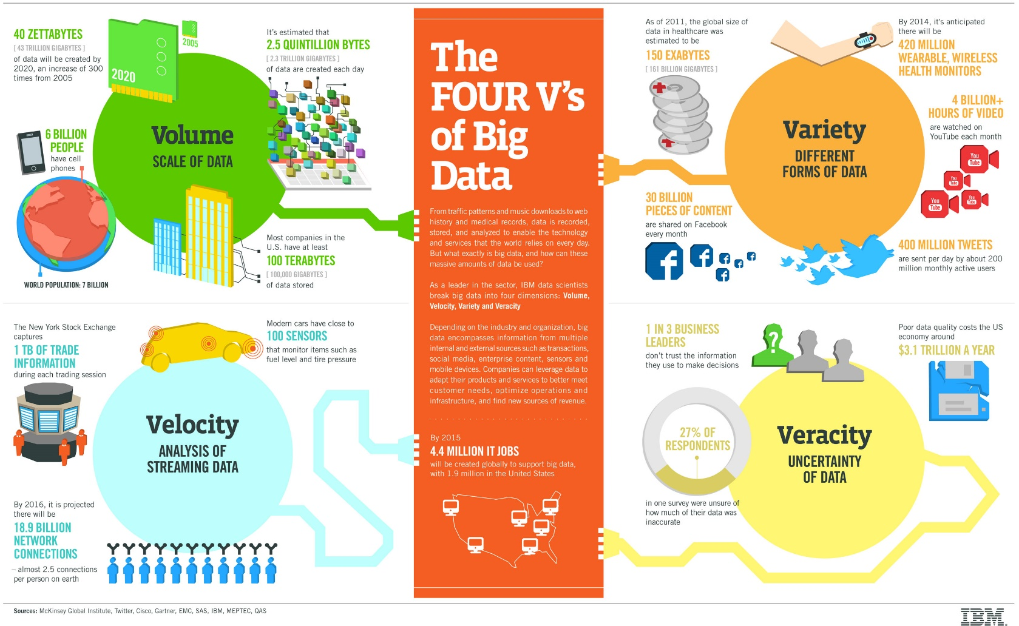
What is it? The 4 v’s of Big Data
Data that has
  Volume
  Velocity
  Variety
  Veracity

Slide 36
What is Deep Learning?
Deep Learning is NOT an algorithm – it is a paradigm of hierarchical learning.
Generally, the paradigm is modeling information representations in the mammalian brain.
“One of the key findings has been that the neocortex, which is associated with many cognitive abilities, does not explicitly pre-process sensory signals, but rather allows them to propagate through a complex hierarchy of modules that, over time, learn to represent observations based on the regularities they exhibit”

Slide 37
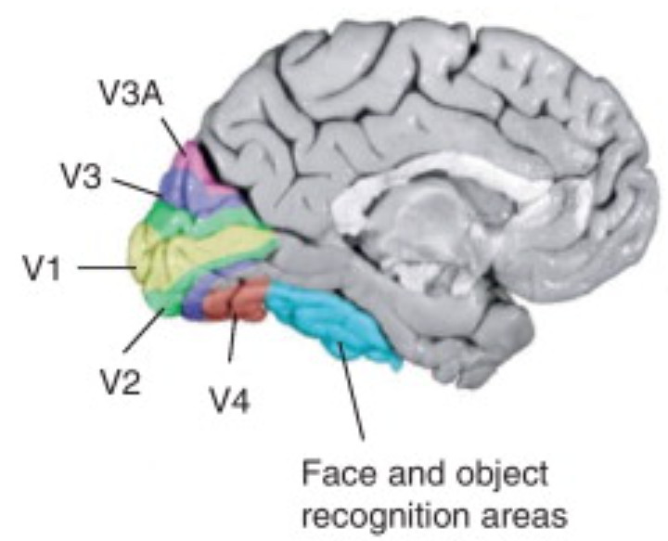
Example – the human visual system
Multi-layered
  Primary visual cortex (v1) – spatial information - spatial frequencies and orientations (also color), Secondary visual cortex (V2) – visual association
  Visual area V3 – coherent motion of large patterns
  Visual area V4 – tuned for object features of medium complexity
  Middle temporal visual area (V5) – perception of motion
  FFA (fusiform face area)

Slide 38
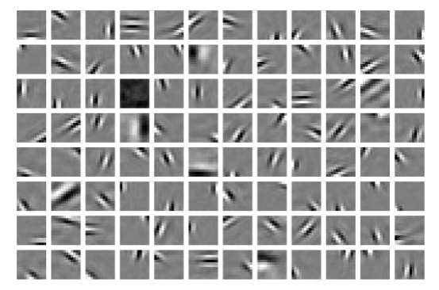
V1 type representations can be learned using sparse coding…
As an example of this type of learning, consider a multi-layered representation where layer 1 creates sparse features using a learning approach that preferred sparse weights:
It turns out that this is very similar to the representation of visual stimuli in V1
In order to create this representation you need a LOT of training data
This representation (often included in deep learning) can be learned using a CNN (convolutional neural net) but I preferred a more direct approach from Olshausen and Field:
http://www.nature.com/articles/381607a0
or ICA…

Slide 39
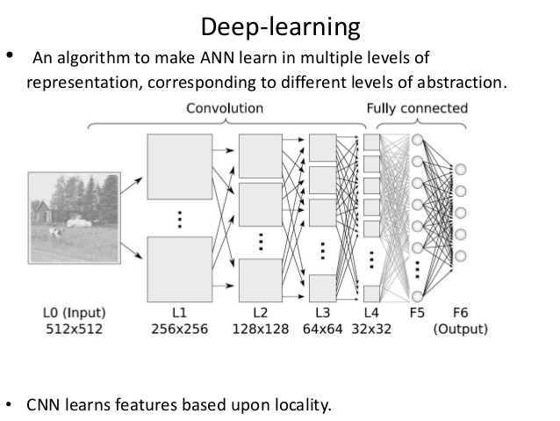
Typical Deep Learning Structure

